Slide 1
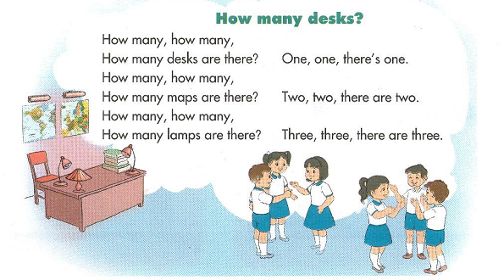

Slide 2
Unit 14: Are there any posters in the room? (L3)

Slide 3
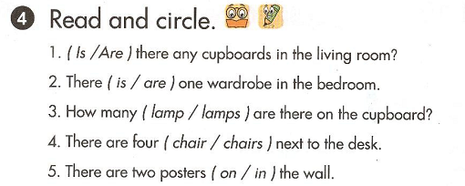

Slide 4
